Slide 1
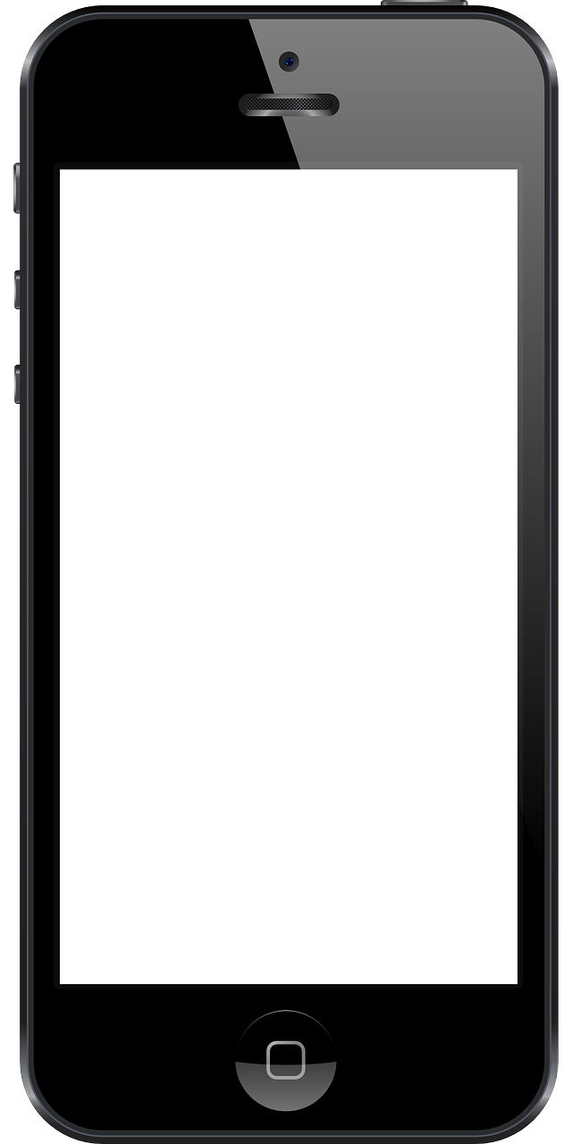
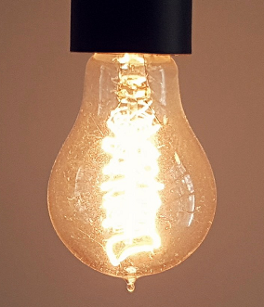
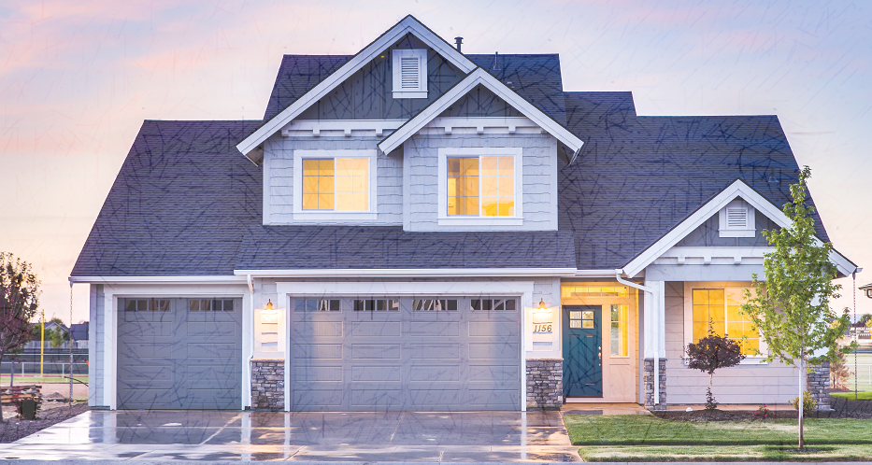

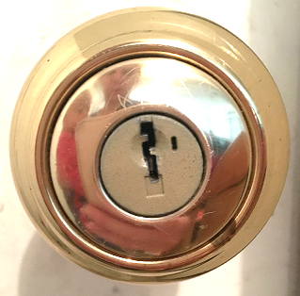
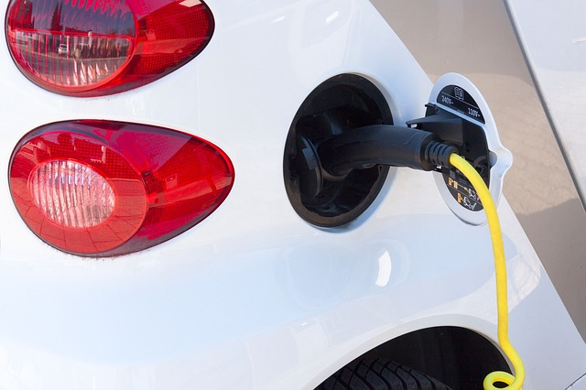
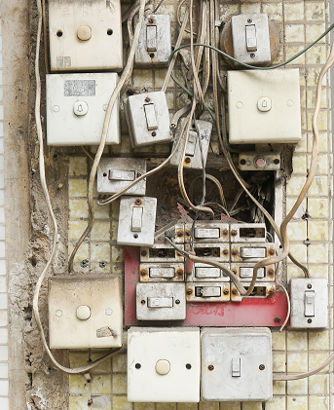
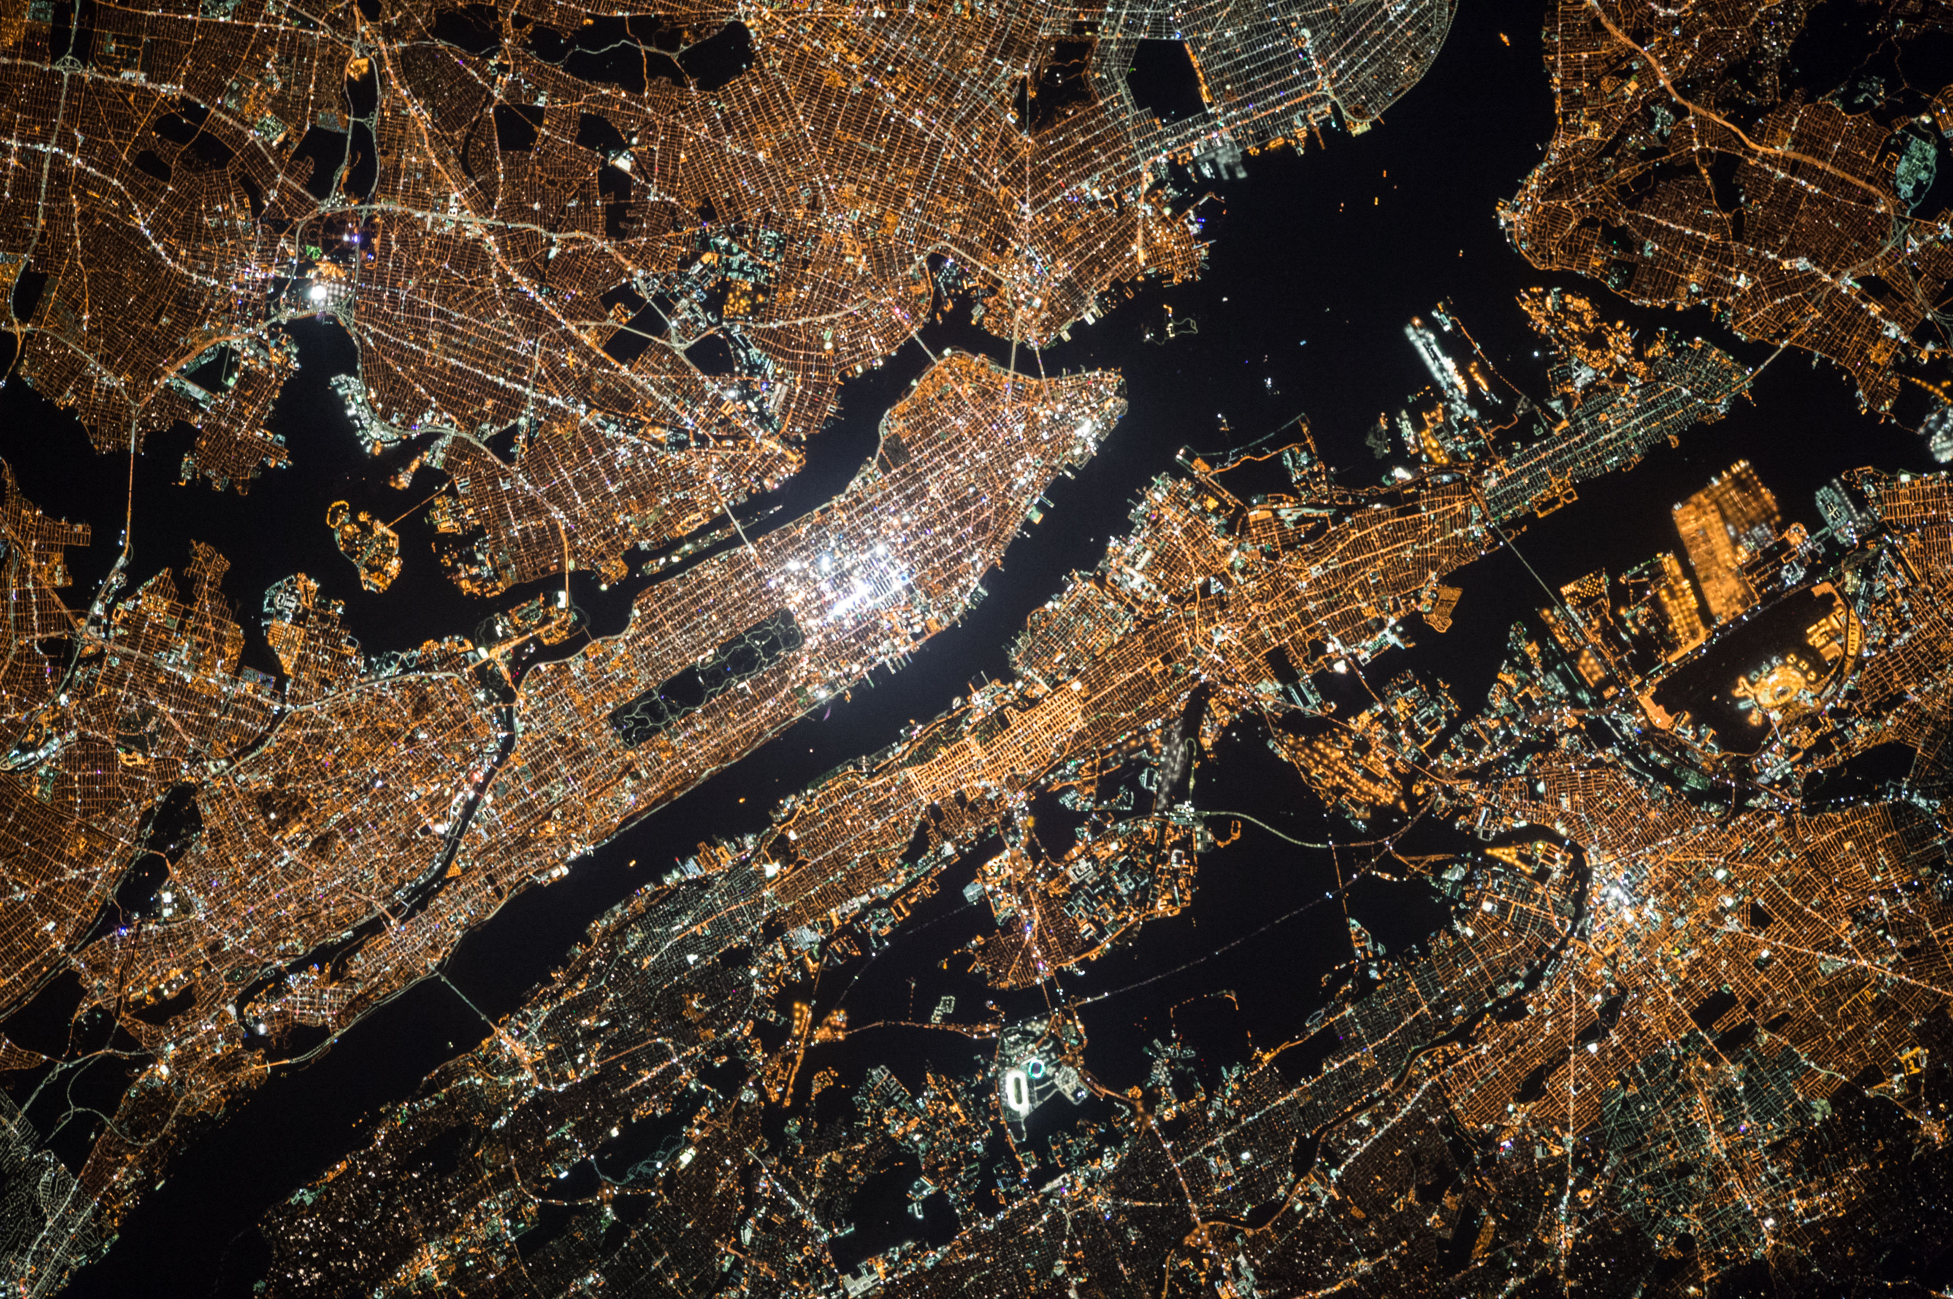

Accessors: Scalable IoT Programming <name list>
Programming the Internet of a Few Things:
Programming the Internet of Everything?
Vision: Write once, run everywhere.
dark?
lights on
charge car
lock door
Extremely heterogeneous
Motes to mainframes; Rooms to cities
Control systems
Real-time; Highly distributed
With high reliability required
Robust; Safe

